Slide 1
History of Photo
Part Two: 1900-1950
Mr. Zeko-Digital Photo A

Slide 2
1902: Alfred Steiglitz
Experimental American photographer.
Organizes “photo-secessionist” show in New York City.
Declares a “secession” from the general artistic guidelines/restrictions of the era.
Was married to painter Georgia O’Keeffe.

Slide 3
1907: Lumiere Brothers
French brothers.
Patented first commercial color film-called Autochrome plates.

Slide 4
1909: Lewis Hine
Hine was hired by the US national Child Labor Committee to photograph children working in mills.
Was an outstanding photographer documenting New york City and workers.

Slide 5
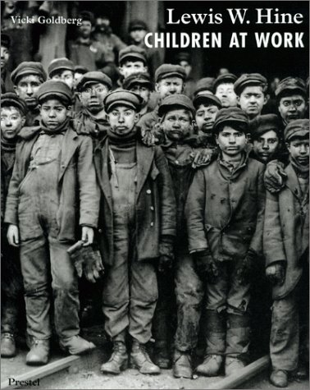

Slide 6
Lewis Hine

Slide 7
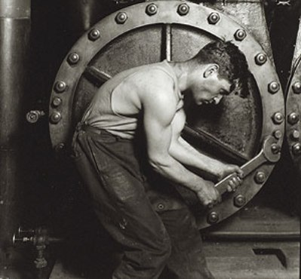
Lewis Hine

Slide 8
1914: Oscar Barnack
Employed by German manufacturer Leitz, develops camera using 24x36mm frame and sprocketed 35mm film.
Beginnings of modern film cameras.

Slide 9
1921: Man Ray
American photographer Man Ray begins making photograms (“rayographs”) by placing objects on photographic paper.

Slide 10
1924: Leica camera
Leitz makes a derivative of Barnack’s camera commercially as the “Leica.”
It is the world’s first high quality 35mm camera.
Still a very expensive, high quality brand today.

Slide 11
1932: Technicolor
Inception of Technicolor for movies.
Three black & white images made in the same camera under different filters to create full color.

Slide 12
1932: Group f/64
Ansel Adams, Imogen Cunningham, Edward Weston et al. form f/64 group dedicated to “straight photographic thought and production.”
It came to imply a specific aesthetic typified by higher contrast, sharper focus, aversion to cropping, and emphasis on the underlying abstract geometric structure of subjects.

Slide 13
1933: Paris de Nuit
Hungarian/French photographer Brassai publish Paris de Nuit (Paris by Night).
The fruit of an 11 year project photographing the city by night and the “night people”-hobos, drunkards, & prostitutes.

Slide 14
1934: Fuji Film
Fuji photo film founded.
By 1938 Fuji is making cameras and lenses in addition to film.
Check out there new “X” cameras-very retro, very cool!
http://www.fujifilm.com

Slide 15
1935: FSA Historical Section
Farm Security Administration hires Roy Stryker to run a historical section.
Stryker hires Walker Evans, Dorothea Lange, Arthur Rothstein et al. to photograph rural hardship over the next six years.

Slide 16
1936: Kodachrome
Development of Kodachrome-the first color multi-layered film.
Development of Exakta-pioneering 35mm single-lens reflex (SLR) camera.

Slide 17
WWII: Life Magazine
Margaret Bourke-White, Robert Capa, Carl Mydans, & W. Eugene Smith cover the war for Life magazine.

Slide 18
1947: Magnum Photo Agency
Henri-Cartier-Bresson, Robert Capa, & David Seymour start the photographer-owned Magnum Picture Agency.

Slide 19
1948: Hasselblad
Hasselblad in Sweden offers its first medium-formatted SLR for commercial sale.

Slide 20
1948: Polaroid
Polaroid sells INSTANT black and white film.

