Slide 1
History of Photo Part 3: 1950-Present
Mr. Zeko-Digital Photo A

Slide 2
1955: Family of Man
American photographer Edward Steichen curates Family of Man exhibit at New York’s MoMA.
The 508 photos from 68 countries representing 273 photographers were selected from almost 2 million pictures.
These photos offer a striking snapshot of the human experience which lingers on birth, love, and joy, but also touches war, privation, illness and death.
His intention was to prove visually the universality of human experience and photography's role in its documentation.

Slide 3
Family of Man

Slide 4
Family of Man

Slide 5
Family of Man

Slide 6
1960: Gary Winogrand Street Photography
American street photographer (1928-1984).
Winogrand was known for his portrayal of American life in the early 1960s. Many of his photographs depict the social issues of his time and in the role of media in shaping attitudes. He roamed the streets of New York with his 35mm Leica camera.

Slide 7
Gary Winogrand

Slide 8
Gary Winogrand

Slide 9
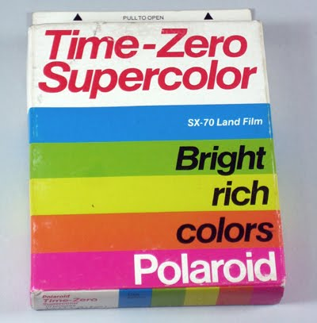
1963: Polaroid Introduces Color Instant Film

Slide 10
1972: Kodak Introduces 110 Format Cameras

Slide 11
1975: Kodak CCD
Steve Sasson at Kodak builds the first working CCD (charged coupled device)-based digital still camera.

Slide 12
1976: First Color Photo Show
American street photographer William Eggleston has first solo show of color photographs at New York’s MoMA.

Slide 13
1983: Kodak Disc Camera

Slide 14
1985: Minolta Maxxum
Minolta markets the world’s first autofocus SLR system called “Maxxum” in the U.S.

Slide 15
1987: Canon EOS Introduced

Slide 16
1990: Adobe Photoshop Released

Slide 17
1991: Kodak DCS-100
Kodak releases DCS-100-the world’s first DIGITAL SLR!
It was actually a modified Nikon F3.
Had a 1.3 megapixel sensor.
Retailed for about $28,000!

Slide 18
1999: Nikon D1 SLR
Nikon introduces D1 SLR-the world’s first “ground-up” DIGITAL SLR-it wasn’t a modified film camera.
It “boasted” 2.74 megapixels.
Retailed for $6,000.-which was a lot in 1999!

Slide 19
2000: The Camera Phone!
Japanese electronics manufacturer Sharp in combination with Japanese phone make, J Phone market the first camera phone.
Was considered a “wacky” gimmick at the time.

Slide 20
2001: Polaroid Goes Bankrupt
2001 Polaroid files for Chapter 11 bankruptcy.
Sold assetts and reformed under Polaroid Corporation name.
Stopped selling cameras in 2007 and stopped selling film in 2009.
Has since reformed with Lady Gaga the new “face” of company.

Slide 21
2003: Four-Thirds Format introduced by Olympus

Slide 22
2003: Canon Digital Rebel
Canon Rebel series is introduced.
First digital SLR’s sold for under $1,000.

Slide 23
2005: Canon EOS 5D
First consumer-priced full-frame digital SLR, with a 24x36 mm CMOS sensor.
Retails for $3,000.

