Slide 1
History of Photography Part 1-Ancient Times-1900
Mr. Zeko: Digital Photography A

Slide 2
Pre-History: Camera Obscura
First recorded description by Arabian scholars c, 900 A.D.
Light is focused by small hole in a darkened room,
Forms a picture on the back wall.
Known as “Camera Obscura”-Italian for “dark chamber”

Slide 3
Pre-History: Portable Camera Obscura
In the 16th century Italian artists shrunk the large chamber to a portable box, replaced the pinhole opening with a lens, added a mirror to invert the image and a translucent ground glass screen to display it. They traced the projected image by hand.

Slide 4
Joseph Nicephore Niepce
French inventor
1820’s –experiments with making pictures using “bitumen of Judea” (asphalt) coated on a metal plate.
He called them “heliographs”
(Helios = sun)

Slide 5
First Recorded Image:1826
View outside Niepce’s garden window.
First known photograph-1826
Bitumen-coated plate in portable camera obscura.
Eight-hour exposure.

Slide 6
Louis Jacques Mande Daguerre
Parisian artist and businessman.
Was interested in a faster way to make pictures.

Slide 7
Niepce and Daguerre
1829-Niepce and Daguerre form partnership.
Process is refined:
Copper sheet
Plated with silver
Fumed over heated iodine
Exposed in camera

Slide 8
First Person to Appear in Photograph
This is believed to be the first photograph of a person (taken by Louis Daguerre in 1838). The street was likely full of people – all in motion and not captured in the long exposure.

Slide 9
Daguerreotype
On January 7th, 1839 Louis Daguerre announces the invention of the “Daguerreotype” to the French Academy of Sciences.

Slide 10
Daguerreotype Mania
Fed a desire for portraits.
Prices were high, but cost was little deterrent.
Quickly became a big business-not just in France but everywhere!

Slide 11
Daguerreotype Mania
Long exposure required subject stillness.
Stiff people or stiff process?
Nearly 500,000 portraits made in Massachusetts in 1845.
Image: Emily Dickinson-1847

Slide 12
Meanwhile in England… William Henry Fox Talbot
British aristocrat.
Loves to draw, but he’s slow and uneven of skill.
Uses camera obscura to make pictures.
Wants to make pictures automatically.

Slide 13
William Henry Fox Talbot
Puts his paper in the back of a camera.
Produces first “negative” image in 1834.
Negative placed in contact with another piece of sensitized paper to produce positive image.
Prints were called “calotypes”

Slide 14
Fox Talbot Images

Slide 15
Photography hits problem…
Daguerreotypes: Sharp- one-of-kind images. or……….Calotype: Multiple copies of fuzzy images.
Solution: Wet-plate collodion negatives-allowed negatives on glass plates, allowing multiple prints that were sharp.
Invented in 1851 by British photographer, Frederick Scott Archer.

Slide 16
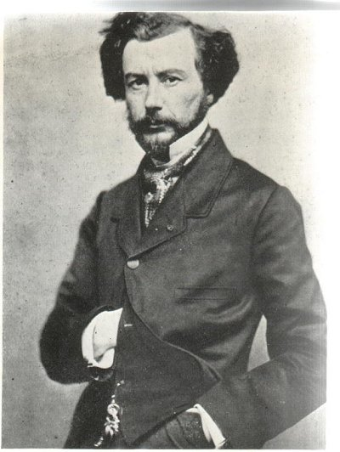
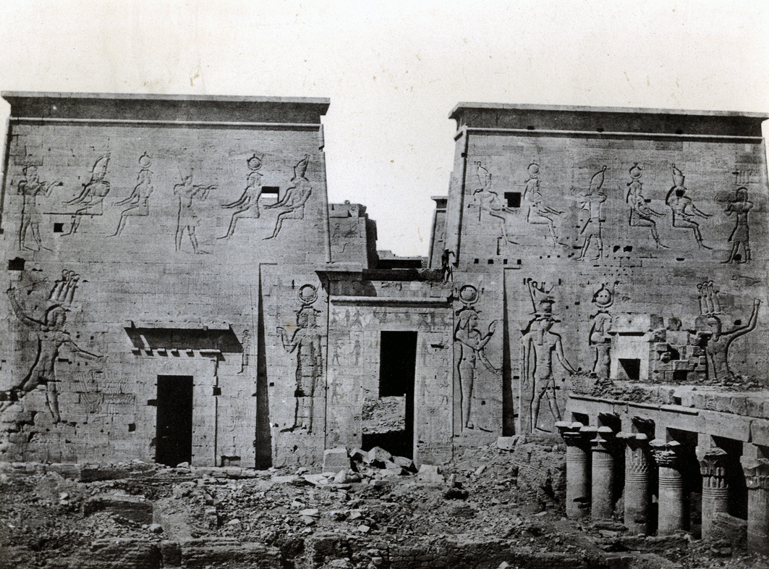
Wet-Plate Collodian Prints
The Sphinx & Pyramids-1851
Maxime du Camp

Slide 17
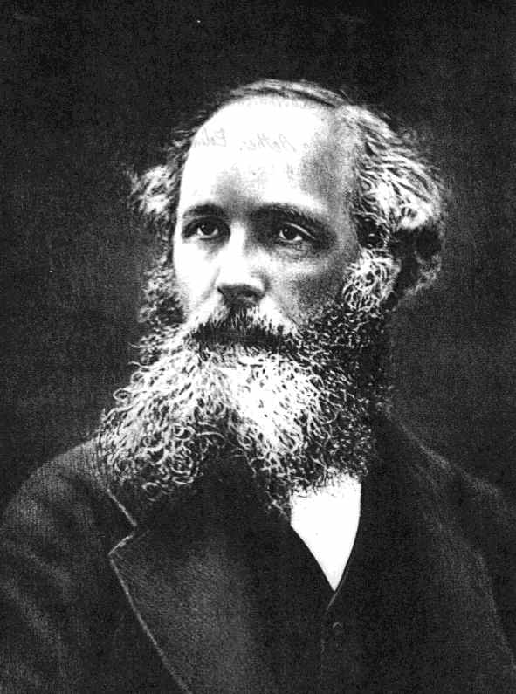
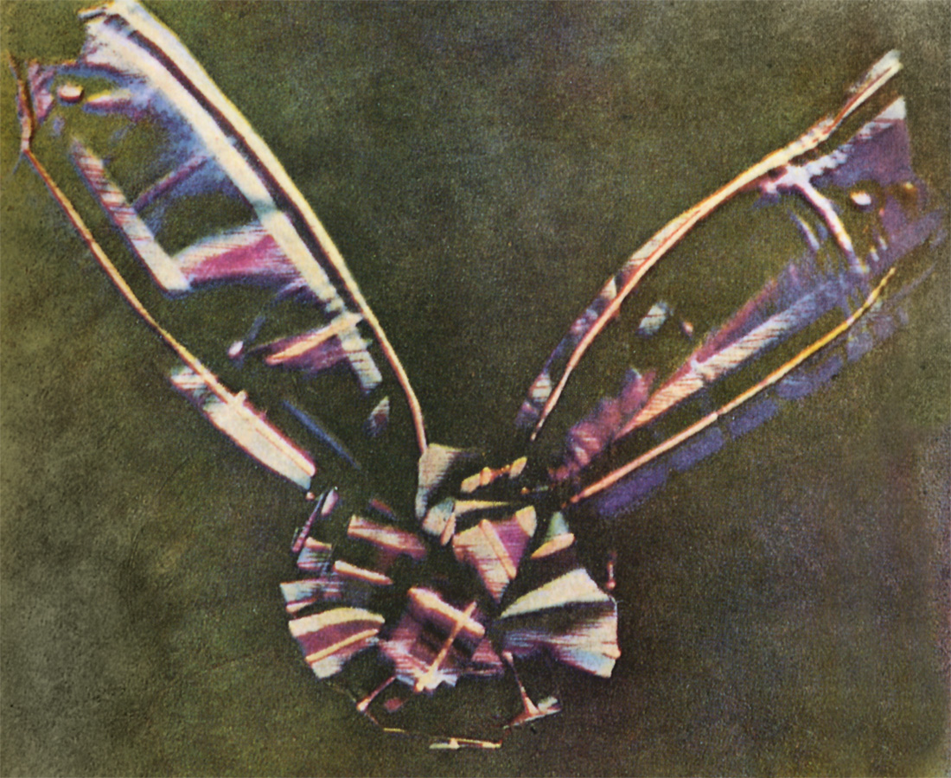
Color Photography: 1861
Maxwell created the image of the tartan ribbon shown here by photographing it three times through red, blue, and yellow filters, then recombining the images into one color composite.
Scottish Physicist James Clerk Maxwell.

Slide 18
Mathew Brady & Staff American Civil War 1861-1865
Mathew Brady often called the “father of photojournalism.”
Most images taken by his staff.
Photos shot before or after conflicts-not during.
Exposed more than 7,000 negatives.

Slide 19
Brady: Civil War

Slide 20
Brady: Portrait of Ulysses S. Grant

Slide 21
Brady’s Images: Realities of War

Slide 22
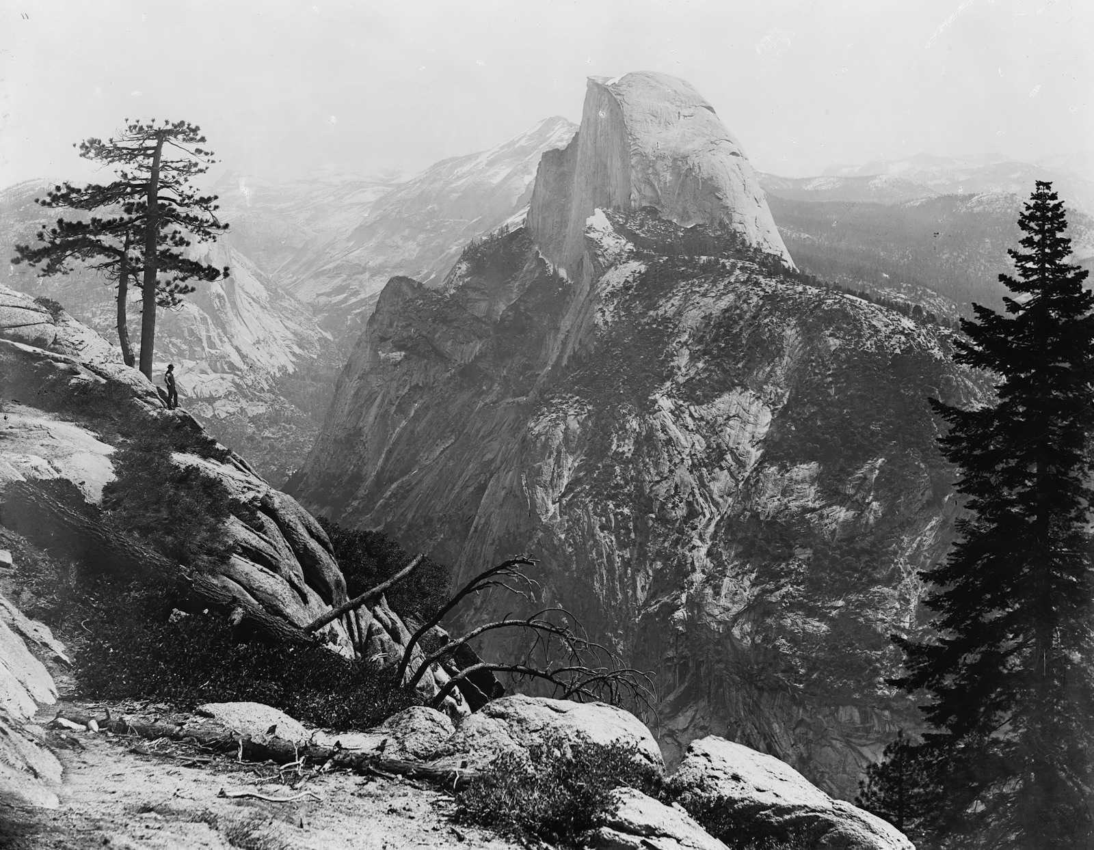
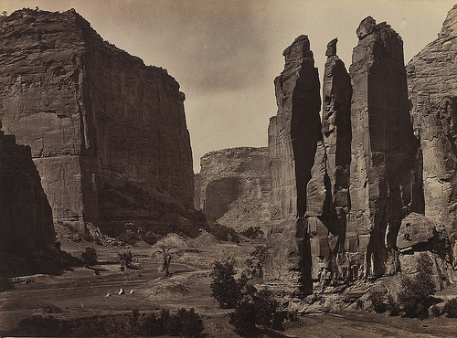
Period of Wet Plate Photography: American West (1870’s)
William Henry Jackson
Carried heavy equipment on mules.
Tim O’Sullivan
U.S. Congress sent photographers to document the West.

Slide 23
Jackson: Wyoming

Slide 24
Eadweard Muybridge Stopping Motion: The beginning of movies
Born in England.
Experimented with time-sequences photography
Asked to settle bet between Leland Stanford (University founder) and another rich San Franciscan.
“Do a horse’s four hooves ever leave the ground at once?”
Set up 12 cameras around the track with trip wires that fired the cameras.

Slide 25
Muybridge: Stopping Motion

Slide 26
George Eastman
Born in Waterville, New York.
At age 24 sets up Eastman Dry Plate Company in Rochester, New York.
In 1884 takes out patent for “roll film”
In 1888 first Kodak camera contains a 20 foot roll of paper.
In 1889 improved Kodak camera has roll of film instead of paper.

Slide 27
Kodak Brownie: 1900
Slogan- “You press the button, we do the rest.”
First model had an initial cost of $1.
Popularized low-cost photography-introduced the idea of the “snapshot.”
Brought photography to the masses.

