Slide 1
Mr. Zeko: Digital Photo A
Camera Basics

Slide 2
Photo-graphy
Photo=Light
Graph=Record

Slide 3
Camera=Chamber

Slide 4
Always Two Parts: Body (chamber)+ Lens

Slide 5
Recording Medium Has Changed
16th Century: portable camera obscura-artist traced projected image.
19th Century until 2000-various types of films & chemicals.
21st Century: digital image sensors.

Slide 6
Artist

Slide 7
Films

Slide 8
Image Sensors

Slide 9
Exposure
Exposure is the amount of light allowed to fall on a photographic medium (film or image sensor) during the process of taking a photograph.

Slide 10
Exposure Triangle: 3 controls effect exposure:
Aperture
Shutter
ISO

Slide 11
Aperture
The opening in a photographic lens that admits the light.
The size of the opening at the time photo is taken.
It is measured in f-stops.
Typical f-stops: 1.4, 2, 2.8, 4, 5.6, 8, 11, 16, 22
Aperture is measured in fractions-thus the smaller the number, the larger the opening.

Slide 12
Aperture/f-stop table

Slide 13
Aperture/Depth of Field

Slide 14
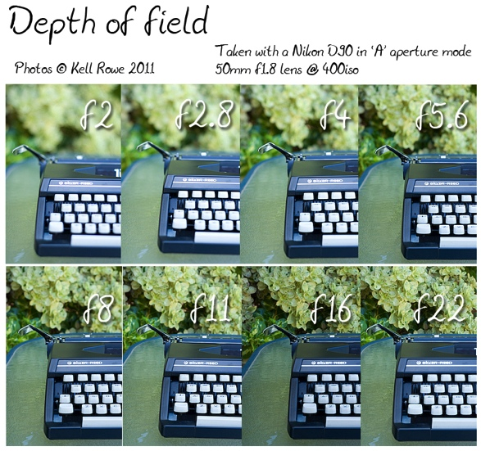
Aperture/Depth of Field-2

Slide 15
Shallow Depth of Field

Slide 16
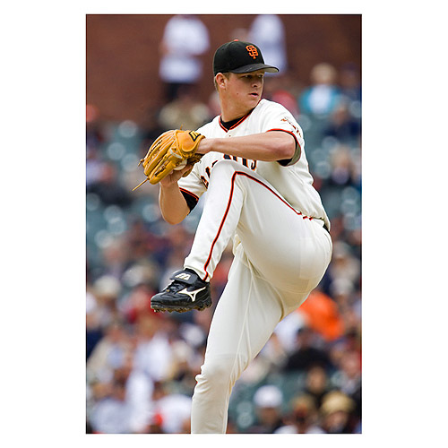
Shallow Depth of Field

Slide 17
Deep Depth of Field

Slide 18
Deep Depth of Field

Slide 19
Shutter Speed
Shutter speed is how long the shutter is open when taking a photograph.
The longer the shutter speed, the more light is recorded; conversely, the shorter the shutter speed, the less light is recorded.
Typical shutter speeds: 1000, 500, 250, 125, 60, 30, 15, 8, 4, 2, 1, 1”
Shutter speeds are measured in fractions of seconds-thus the larger the number the shorter the length of time.
Any number followed by quotation mark means seconds-thus 4” equals 4 seconds.

Slide 20
Shutter Speed Reference Chart
Bulb For use in very low light conditions like night photography. With this setting the photographer controls how long the shutter stays open. Any movement within the frame or by the camera will show up as motion blur. A tripod must be used.
1 second to 1/15 For use in low light conditions, night photography, fireworks, etc. A tripod must be used to prevent motion blur.
1/30th For use when implying motion by panning with a moving object as a photo is taken. The subject appears sharp while the background becomes motion blur. Also used in darker conditions and requires a tripod to prevent motion blur.
1/60th to 1/125th Common shutter speeds for most existing light situations. These shutters speeds combined with small apertures (f/8 to f/166) result in large depth of field.
1/250th Good for freezing human paced action like a person jogging.
1/500th Good for freezing faster moving objects such as a car or runner.
1/1000th and faster Good for freezing objects that move faster than the eyes can see, such as a bird’s wings in flight or baseball pitch.

Slide 21
Shutter Speed/Motion

Slide 22
Fast Shutter Speed

Slide 23
Slow Shutter Speed

Slide 24
Really Slow!/Bulb (B)

Slide 25
3. ISO
In photography, an ISO number is an indication of the sensitivity of the image sensor, where a higher number indicates higher sensitivity.
This is usually expressed as a range, e.g. ISO 100 - 1600.
A higher sensitivity allows us to take pictures in low light without using flash. However, this gain usually comes at a price: as we amplify the light signal, we also amplify the noise signal, and high ISO images are usually more "noisy" than low ISO images.

Slide 26
ISO/Settings

Slide 27
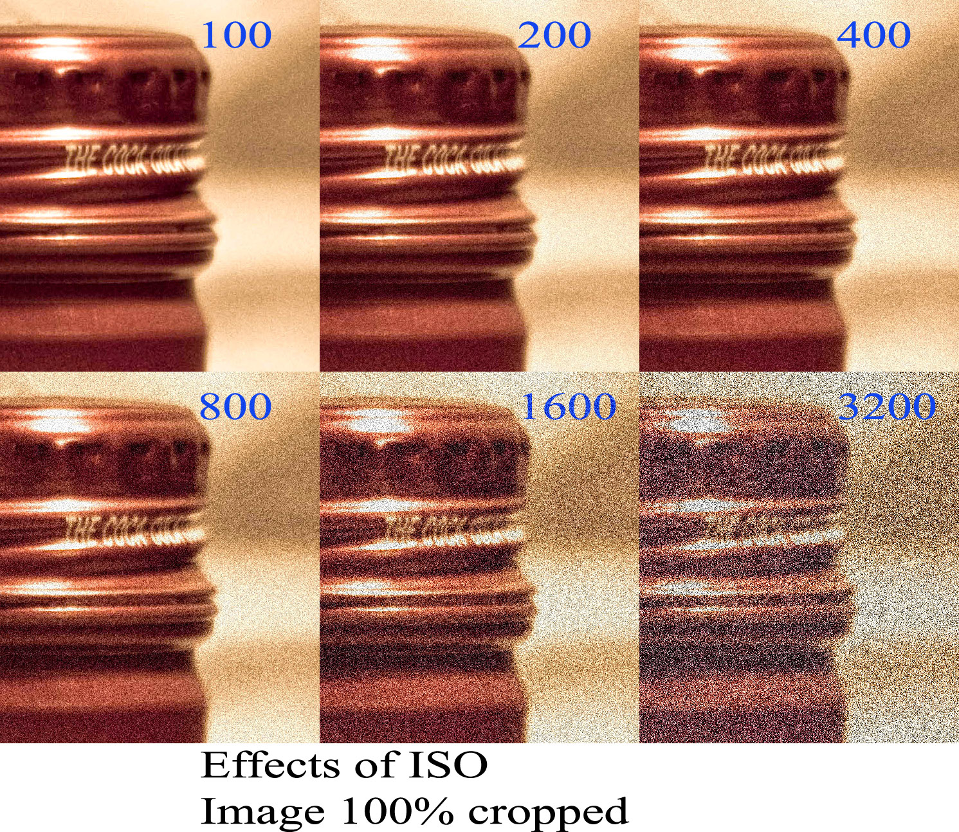
ISO/Image Quality

Slide 28
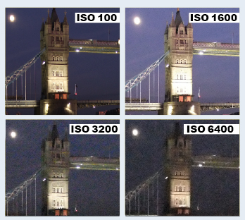
ISO/Image Quality

Slide 29
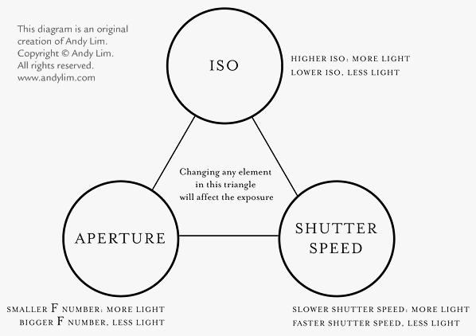
Putting it all Together

Slide 30
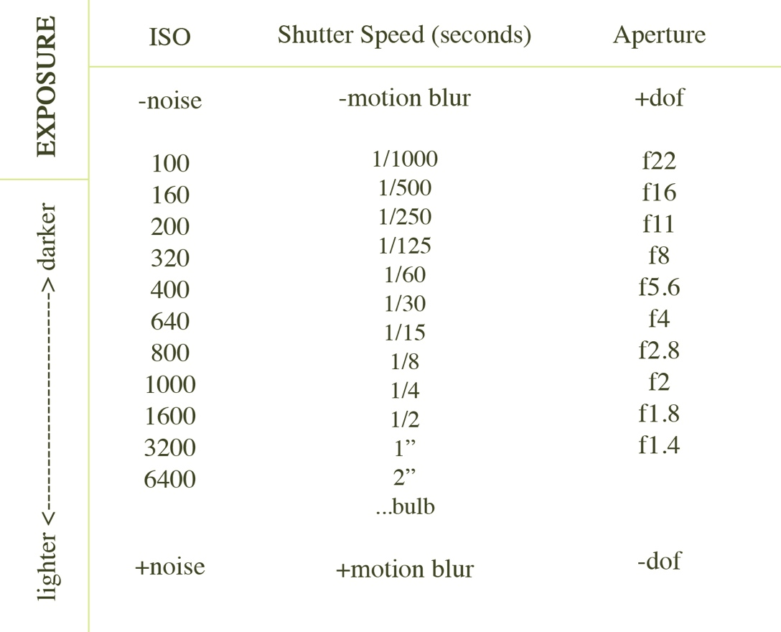

Slide 31
